Slide 1
Introduction to MUSIC and how to identify enriched regions (ERs) at different scales
Arif Harmanci
3/16/2015
arif.harmanci@yale.edu

Slide 2
Histone Modification Peaks: Scale does matter
Peak calling algorithms for transcription factor binding identifies events that happen at very small length scales
At most several hundred base pairs
Histone modifications (“TF”’s like RNA Polymerase) have a wide range of scales at which enrichments are detected.
Which scale to use depends really on the analysis to be performed
MUSIC performs the multiscale analysis to identify ERs at different scales

Slide 3
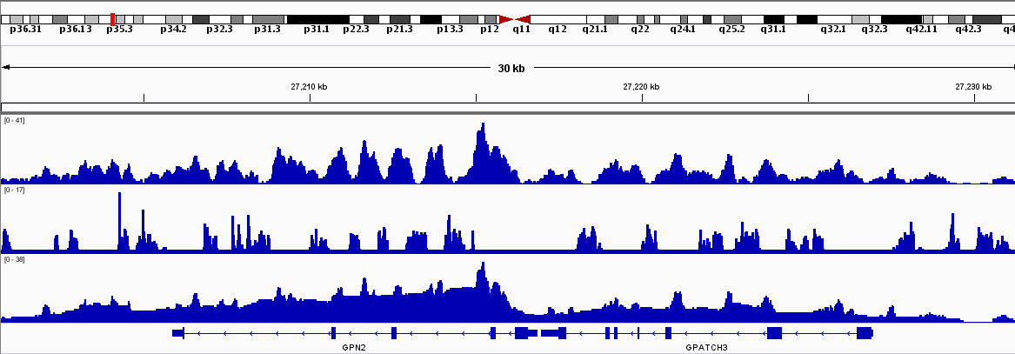
Long ERs: Mappability is important
Non-mappable regions in the genome cause dips in the signal that makes it necessary to include mappability into account, otherwise the ERs tend to get fragmented (a lot)
H3K36me3
Multi-mappability
Corrected

Slide 4
How to start using MUSIC
Make sure we have the (multi-)mappability whenever it can be generated.
We have generated the mappability profiles for several organisms:
http://archive.gersteinlab.org/proj/MUSIC/multimap_profiles/
If is not there, you can generate it using bin/generate_multimappability_signal.csh
If you get lazy, drop me an email ^{(arif.harmanci@yale.edu)} and let me know for which species you need the mappability to be generated and I will create it and put it online

Slide 5
I got the mappability profile and I have my reads. Whats next?
You need to preprocess the reads.
We could do this automatically but as you can see, these reads can be used for different purposes (scale spectrum computation or ER identification) so it is good to have these ready
Use –preprocess option.
Following this, you need to sort (-sort_reads) and remove duplicates (-remove_duplicates)

Slide 6
If you would like to just call peaks, can take the short route and be done:
We added run_MUSIC.csh under bin/
This script does parameter selection (l_p) then run ER calling with the default scale levels. These work well in most of the cases.
Punctate ER calling:
run_MUSIC.csh -get_optimal_punctate_ERs [chip preprocessed dir] [input preprocessed dir] [Multi-mappability profile directory]
Broad ER calling:
run_MUSIC.csh -get_optimal_broad_ERs [chip preprocessed dir] [input preprocessed dir] [Multi-mappability profile directory]
TF peak calling: No need for parameter selection
MUSIC –get_TF_peaks –chip [chip preprocessed dir] –control [input preprocessed dir] -mapp [Multi-mappability profile directory] –l_mapp [read length]

Slide 7
I don’t want to use default setting, take me through parameter selection. Ok here we go:
Arif: I always identify l_p parameter, which is vital for defining what is significant. This value changes with changing sequencing depth, so make sure you identify this value first.
-get_per_win_p_vals_FC option. This option evaluates several window lengths and reports estimates of false positive rate and sensitivity for different l_p values and reports it in a file named per_l_win_accuracy_stats.txt, where each line looks like this:
l_win: 1700 FNR: (FC:0.001) (p-val:0.001) FPR: (FC:0.0101) (p-val:0.0055) Sentitivity: 0.999
I set l_p to the largest l_win such that where FPR for FC and p-value is below 1% (or very close)
Personally, we like inspecting this file since it gives an idea about whether the enrichment worked well.
If you don’t want to look at this file run MUSIC with ‘-l_p 0’, which tells MUSIC to select l_p parameter automatically from the file above.
You have to still run -get_per_win_p_vals_FC for this to work.
We added a script under bin/run_MUSIC.csh that automatically selects and runs MUSIC with the best l_p parameter. When you do not want to deal with looking at this file, use this script.

Slide 8
Ok, I have selected l_p. What should I do next?
Arif: Next thing I do is look at the scale spectrum of the profile I have.
Use –get_scale_spectrum option for this. Make sure you set l_p to the selected value from previous slide using –l_p option.
After you run MUSIC with –get_scale_spectrum, it writes a file named per_scale_stats.txt with lines like this:
27 56815.13 111 11675769
Column 1: Scale index
Column 2: Scale length (in base pairs, take nearest integer)
Column 3: Number of ERs that are specific to this scale length
Column 4: The covearge of the ERs

Slide 9
Ok, I have selected l_p. What should I do next?
Arif: The 4 column per_scale_stats.txt file is what you need to plot the spectrum. I use the 4th column (coverage of ERs at each scale) and plot it to visualize the scale spectrum. In MATLAB:
load(‘per_scale_stats.txt ‘);
figure;
semilogx(per_scale_stats(:,2), per_scale_stats(:,4)./sum(per_scale_stats (:,4)));
It is useful to plot the x-axis in log scale.
This plot gives you a good idea about which scales get enriched in your experiment. Now select scale levels that you would like to analyze.
For this, I usually decide whether the scale spectrum is shifted towards higher scales, if so, I use the default broad ER calling parameters (-get_multiscale_broad_ERs)
Otherwise I use punctate option
(-get_multiscale_punctate_ERs)

Slide 10
A Special Note on Punctate Marks
When you evaluate the scale spectrum file and it turns out that the dominating scale is at lower scales, there may be a risk that the selected l_p parameter is underpowered (i.e., yields low sensitivity)
To compensate for this, you may want to change l_p parameter to the larger of dominating scale level and l_p identified in previous steps, i.e., the parameter you identified in slide 6.
Or, just use the default MUSIC parameters.

Slide 11
Finally, ER identification?
Yes. For this, we will use the scale levels that we are interested in. Note that in the manuscript, we did a thorough analysis to identify the scale levels for human datasets. If you have human datasets, the default parameters work pretty well.
For ER identification, run MUSIC with
-get_multiscale_broad_ERs option. If you want to change the default scale parameters, make sure scales are specified with –begin_l and –end_l and l_p is specified with –l_p options.
Don’t forget to specify mappability profile with
–mapp. With this, you also need the read length at which the mappability profile is generated, use
–l_mapp to specify it.
Broad Marks (-get_multiscale_broad_ERs)
H3K36me3, H3K27me3, H3K9me3, H3K79me2, H4K20me1, …
Punctate Marks (-get_multiscale_punctate_ERs)
H3K4me3, H3K27ac, H3K4me1, Pol2, …
MUSIC identifies the troughs only for these ERs
TFs (-get_TF_peaks): Activators, Repressors, insulators,
A lot; CTCF, Oct2, Sox4, Nanog, P300, CBP, …

